Slide 1
Time Series Outlier Detection
Hitesha Mukherjee - MS2016007
Srinivasa Raghavan – MS2017008
Anoop Toffy – MT2016016

Slide 2
Problem Statement
Identification of outliers in Time Series data using robust statistical methods.

Slide 3
Dataset
The dataset is provided as part of the Yahoo! Web Scope program. The dataset consists of real and synthetic time-series with tagged anomaly points. The synthetic dataset consists of time-series with varying trend, noise and seasonality. The real dataset consists of time-series representing the metrics of various Yahoo services.
The A1Benchmark is based on the real production traffic to some of the Yahoo Servers. The other 3 benchmarks are based on synthetic time-series. A2 and A3 Benchmarks include outliers, while the A4Benchmark includes change-point anomalies. The synthetic data set contains time-series with random seasonality, trend and noise. The outliers in the synthetic dataset are inserted at random positions.

Slide 4
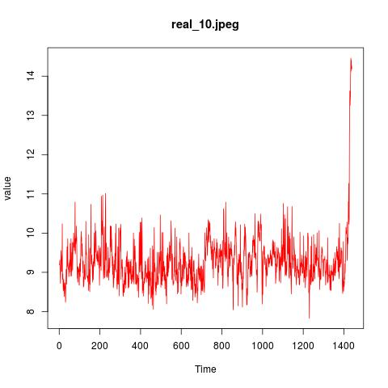
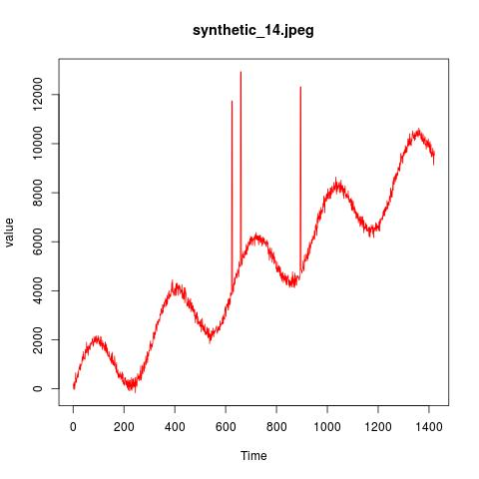

Slide 5
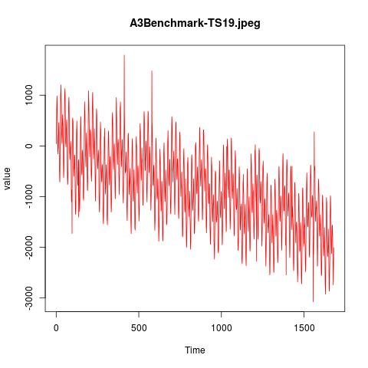
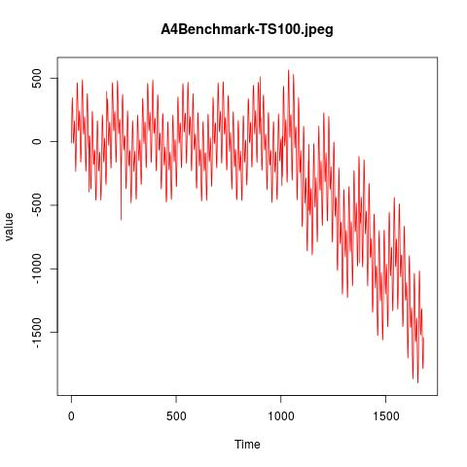

Slide 6
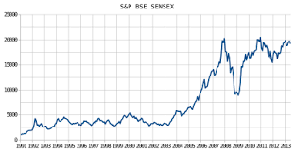

Time Series Analysis
A Time-Series is a sequence of data points corresponding to a set of observations made at a particular time instance e.g.- Rainfall data in a year, solar radiation data, speech signal, network traffic data, ECG and EEG data etc.
To model or analyze these signals, there is a need to understand the underlying pattern. These patterns may include components such as trends, seasonality, stochasticity, long term cyclicity and autocorrelation etc.

Slide 7
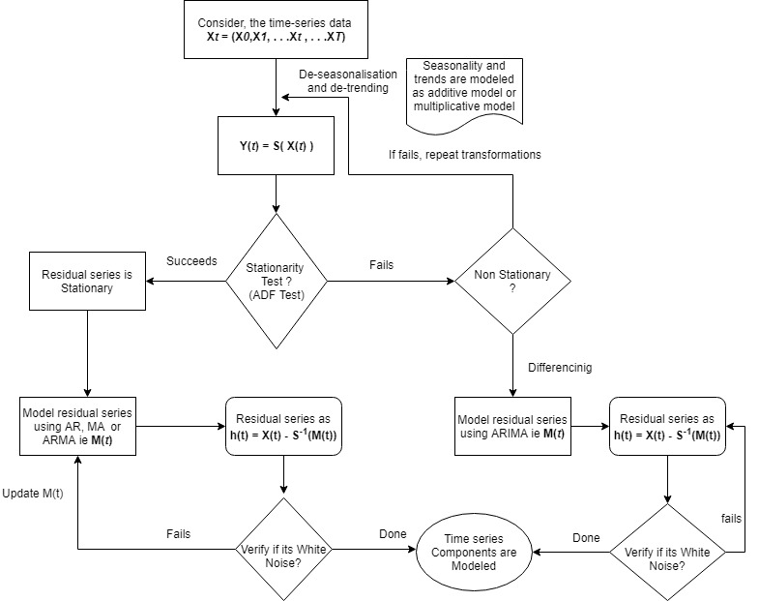

Slide 8

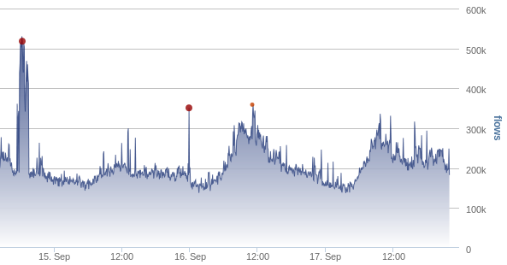
Outliers
Time series may sometime exhibit eccentric pattern that deviate from normal operating behavior because of the presence of outliers.
The data points which are lying outside the regular operating region which results in such deviating characteristics are referred to as outliers.

Slide 9
Types of outliers
Additive outliers (AO)
Level Shift outliers (LS)
Temporal change outliers (TC)
Innovation outliers (IO)

Slide 10
Approach
Joint estimation model parameters and outlier effects in time series for A1,A2,A3 Benchmark datasets
MARS modelling and recursive partitioning for A4 Benchmark dataset containing change points

Slide 11

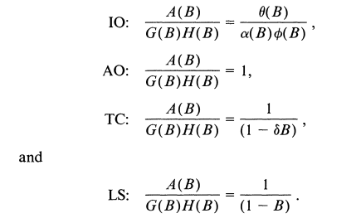
A. Joint estimation model parameters and outlier effects
Joint model equation

Slide 12
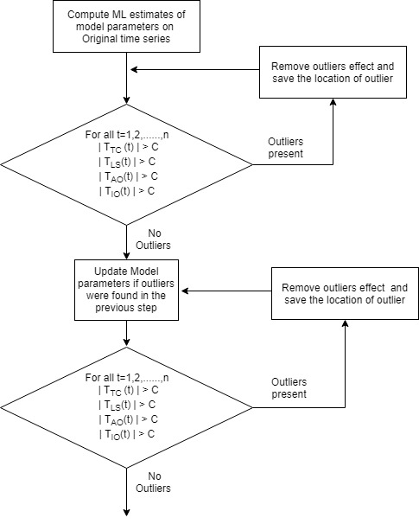
Iterative Procedure Stage 1 :Initial Parameter Estimation and Outlier Detection

Slide 13


Stage 2 : Joint Estimation of Outlier Effects and Model Parameters
After stage 1 we get m possible outlier locations t1,t2,…,tm
Joint equation

Slide 14
Stage 2 : continued
Out of the m outliers identified as the possible outliers. We re calculate the t-statistic and see if its effect is significant , if not remove it from the m outliers and repeat the process
Obtain the adjusted series from by removing the outliers effects
Compute the maximum likelihood estimates of the model parameters based on the adjusted series obtained. If the relative change of the residual standard error from the previous estimate is greater than epsilon repeat the above stage 1

Slide 15
Stage 3 : Detection of Outliers Based on the Final Parameter Estimates
Compute the residuals by filtering the original series based on the parameter estimates obtained in stage 2.
Obtain the adjusted series from by removing the outliers effects.
Use residuals and iterate through stage-1 and stage-2 to obtain the final model parameter estimates and outlier effects

Slide 16
B. MARS modelling and recursive partitioning for A4 Benchmark dataset containing change points

Slide 17
Approach B
If we have change points in the time series, we use Multivariate adaptive regression splines(MARS) fitting to find the knots/change points in the time series. Prior to applying MARS using EARTH (Enhanced Adaptive Regression Through Hinges) package in R we perform moving average smoothing.
After getting sub series using the knots, we use Approach A to find outliers.

Slide 18


Slide 19
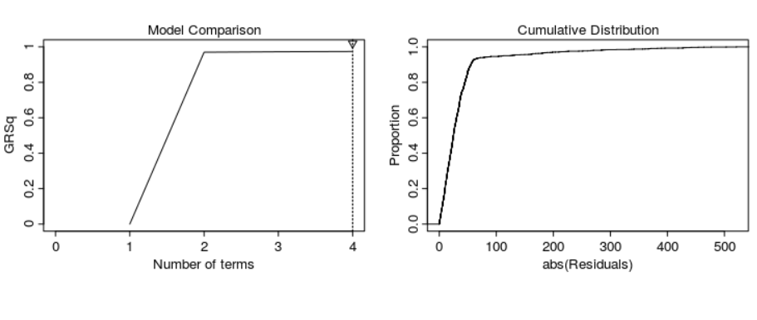

Slide 20
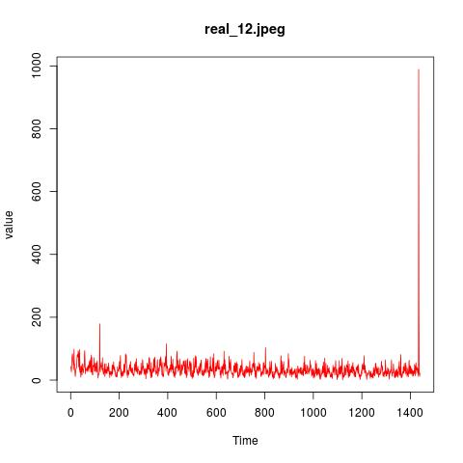
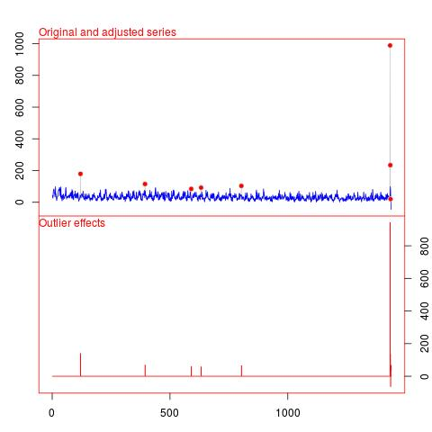
Results

Slide 21
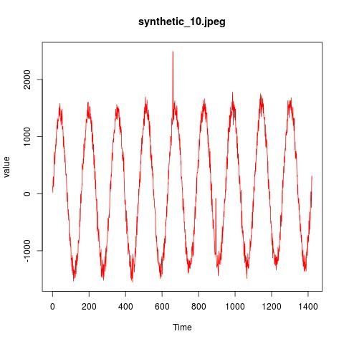
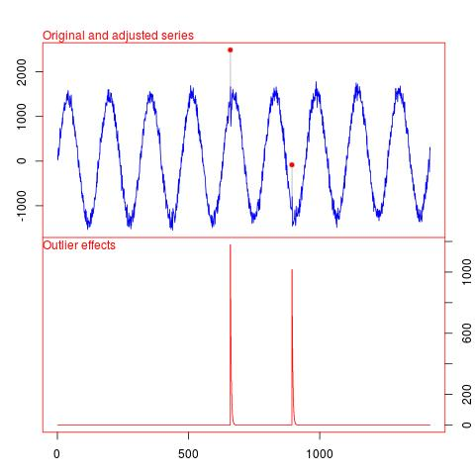
Results

Slide 22
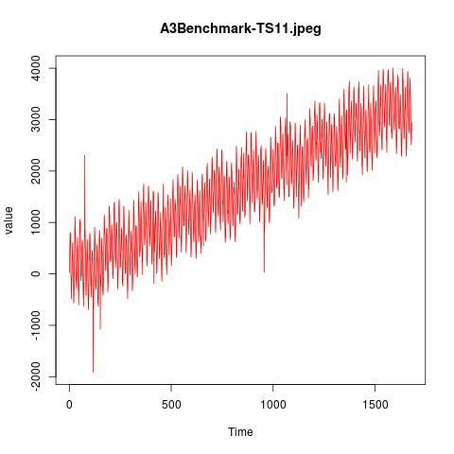
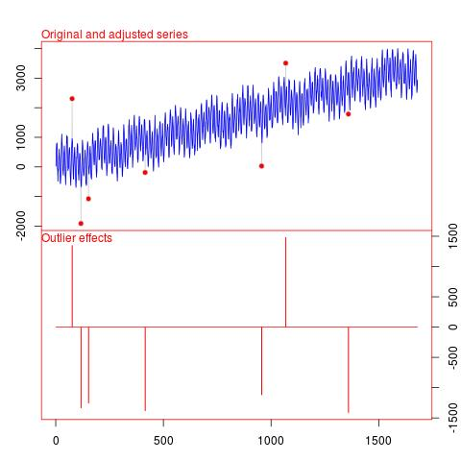
Results

Slide 23
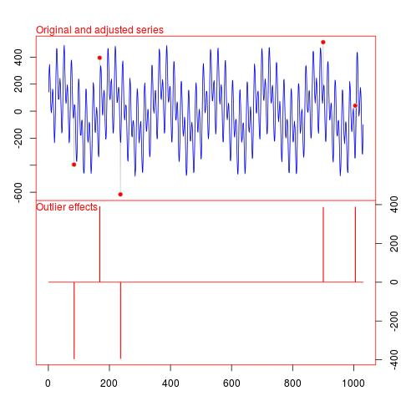
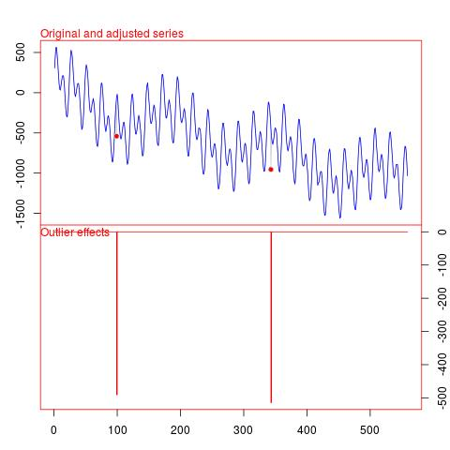

Slide 24
Questions

Slide 25
THANK YOU

